Slide 1

Project
PTDA16
LinkedIn – Job Analysis
Kartikeya Bhatia
Naman Sharma
Saurav Sagar Pandey
Greeshma Tom

Slide 2
Content
Objective
Problem Statement
Challenges
Insights
Learnings
Result

Slide 3
Objective
Scrape data from professional networking platform Linkedin using python library Beautifulsoup and collate information.
Combine tables and manipulate data using SQL.
Present insights using excel.

Slide 4
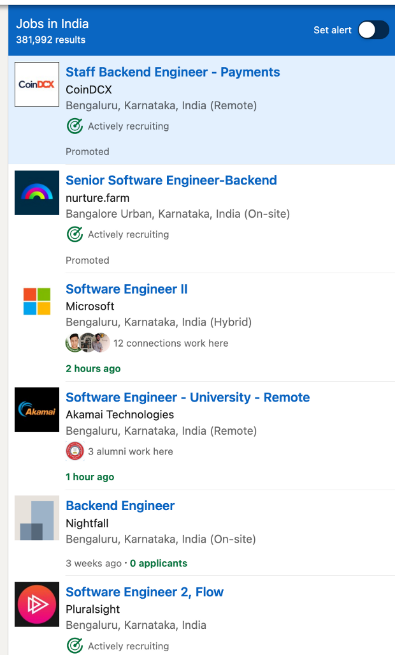
Problem Statement
Extract data from LinkedIn.
Convert data into csv files.
Connect & clean the data.
Pick up Insights.

Slide 5
Challenges
Web scraping
Login in secure server
Automation
Extracting clean data
Correlating the data

Slide 6
According to the data we have we can see that VEGROW company has the highest number of followers and Upgrad centre in Assam has the least number of followers.

Slide 7
The donut chart shows that job availability is high in Maharashtra compared to other states in India.
The bar chart shows that the number of companies providing openings are more in Bengaluru, Karnataka compared to other cities in India.

Slide 8
From the column chart we can see that Emids company has received the largest number of applications for job.
From the pie chart we can see the highest number of jobs are available in the HR department of companies.

Slide 9
Learnings
Automation through selenium
Web scraping using beautifulsoup
Manipulating data using SQL
Creating interactive dashboard

Slide 10
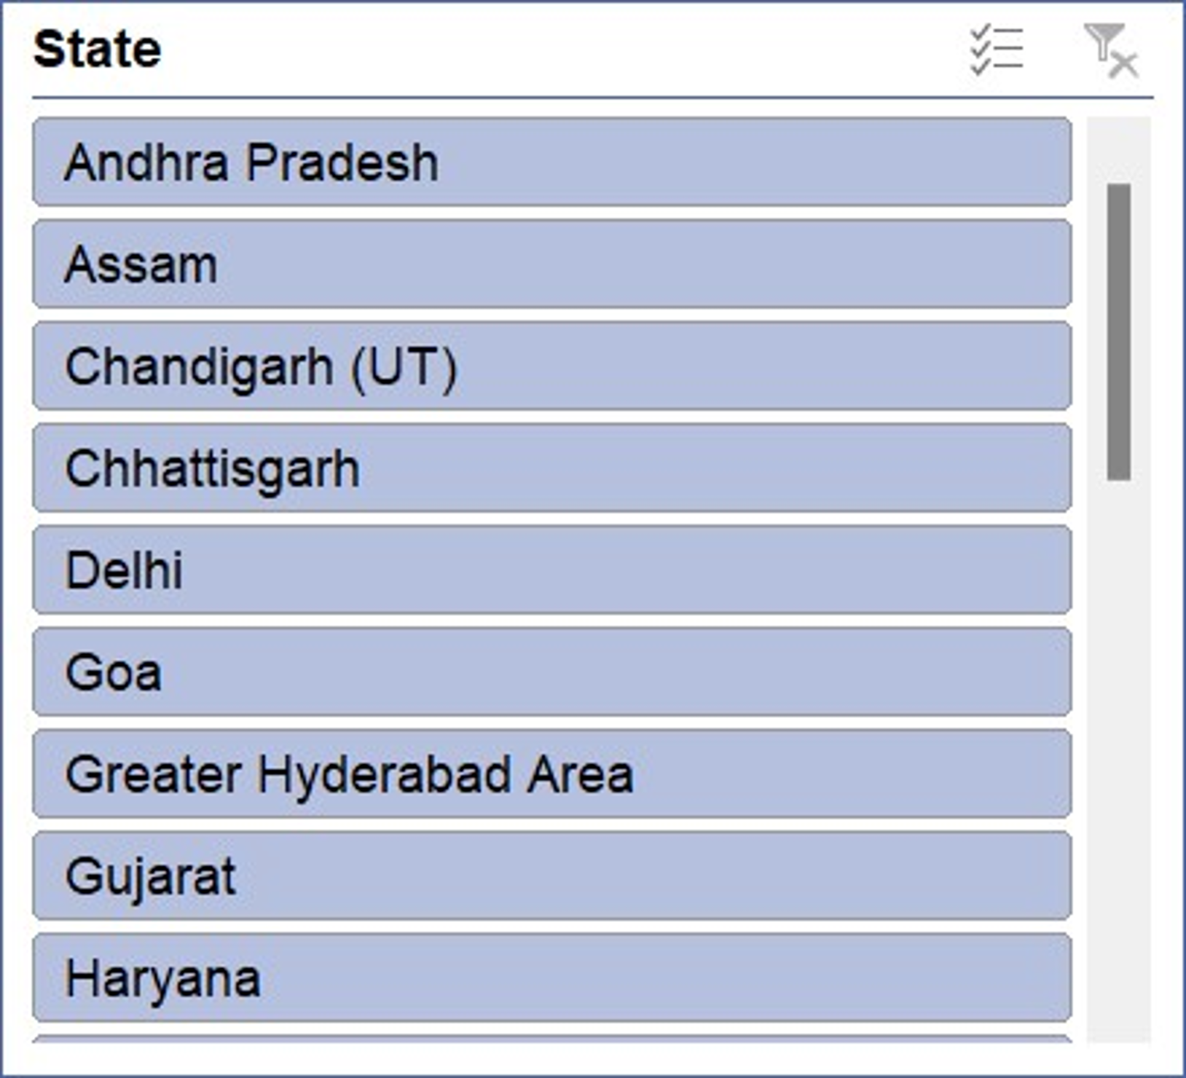
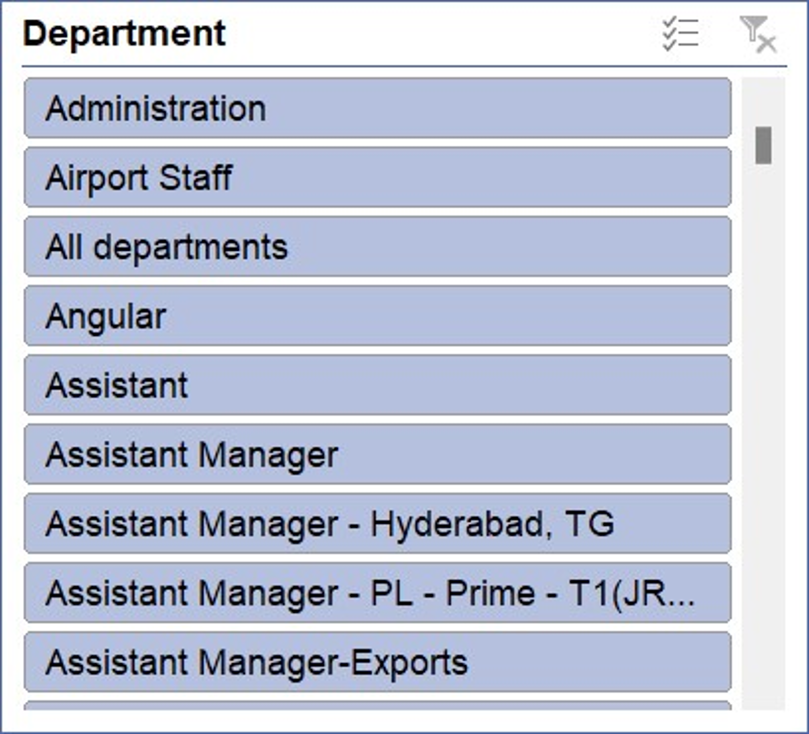
LinkedIn – Job Analysis Dashboard

Slide 11
THANK YOU

